Slide 1
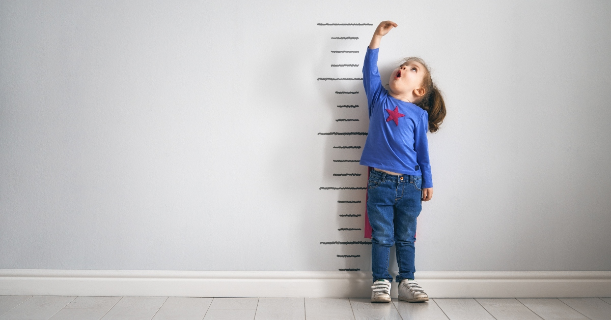
Short Stature
Dr. Thafir Tawfiq Aldawood
Pediatric Endocrinologist

Slide 2
Short stature is defined as height below the third percentile or greater than two standard deviations (SDs) below the mean height for chronological age.

Slide 3
Causes of short stature
Normal variant
Constitutional
Familial
Endocrinological
GH deficiency
Hypothyroidism
Diabetes Mellitus
Cushing Syndrome
Nutritional deprivation
Malnutrition,FTT
Psycological
Intrauterine growth retardation
Skeletal dysplasia
Achondroplasia
Systemic diseases
Malabsorption
Heart diseases
Chronic Kidney disease
Hematological disorder
Inborn error of metabolism
Chronic infection
Genetic syndroms
Turner syndrome
Noonan syndrome
Downs syndrome
Prader willi syndrome
Miscellaneous
JRA

Slide 4
Hypopituitarism denotes underproduction of 1 or multiple pituitary hormones.
Affected children have postnatal growth impairment and other endocrine deficiencies that are specifically corrected by hormone replacement.

Slide 5
MULTIPLE PITUITARY HORMONE DEFICIENCY
Genetic Forms
Congenital Forms … pituitary hypoplasia where GH is most commonly observed hormone deficiency.
Acquired Forms
Traumatic
Infilterative/ inflammatory
Infections
Vascular
Neoplastic
Functional

Slide 6
CLINICAL MANIFESTATIONS
Congenital Hypopituitarism
The child with hypopituitarism is usually of normal size and weight at birth, although those with MPHD and genetic defects have birth lengths that average 1 SD below the mean.
Children with severe defects in GH production or action typically fall more than 4 SD below the mean for length by 1 yr of age.
Those with less-severe deficiencies grow at rates below the 25th percentile for age and gradually diverge from normal height percentiles.

Slide 7
Infants with congenital defects of the pituitary or hypothalamus may present with neonatal emergencies such as apnea, cyanosis, or severe hypoglycemia with or without seizures. Prolonged neonatal cholestatic jaundice is common.
Micropenis in boys provides an additional diagnostic clue. Deficiency of GH may be accompanied by hypoadrenalism and hypothyroidism, as well as gonadotropin deficiency

Slide 8
O/E..
The head is round and the face is short and broad.
The frontal bone is prominent, and the bridge of the nose is depressed and saddle shaped.
The nose is small, and the nasolabial folds are well developed.
The mandible and the chin are underdeveloped and the teeth, which erupt late, are often crowded

Slide 9
The neck is short and the larynx is small. The voice is high-pitched and remains high after puberty.
The extremities are well proportioned, with small hands and feet. Weight for height is usually normal, but an excess of body fat and a deficiency of muscle mass contribute to a pudgy appearance.
The genitals are usually small for age, and sexual maturation may be delayed or absent. Facial, axillary, and pubic hair usually is lacking, and the scalp hair is fine.
Intelligence is usually normal for age, unless there are other structural brain abnormalities,

Slide 10
Acquired Hypopituitarism
The child is normal initially, and manifestations similar to those seen in idiopathic pituitary growth failure gradually appear and progress.

Slide 11
When complete or almost complete destruction of the pituitary gland occurs, signs of pituitary insufficiency are present.
Atrophy of the adrenal cortex, thyroid, and gonads results in loss of weight, asthenia, sensitivity to cold, mental torpor, and absence of sweating.
Sexual maturation fails to take place or regresses if already present.
There may be atrophy of the gonads and genital tract with amenorrhea and loss of pubic and axillary hair.
There is a tendency to hypoglycemia.

Slide 12
If the lesion is an expanding tumor, symptoms such as headache, vomiting, visual disturbances, pathologic sleep patterns, decreased school performance, seizures, polyuria, and growth failure can occur.
Slowing of growth can antedate neurologic signs and symptoms.

Slide 14
LABORATORY FINDINGS
Measurements of IGF-1 and IGF-binding protein levels.
Assess thyroid function.
Exclude chronic medical illness.
CBC, metabolic profile, inflammatory markers,
celiac testing, urinalysis.
Determination of peak GH levels after stimulation test

Slide 15
RADIOLOGIC FINDINGS
Neurologic imaging should be obtained when the cause of hypopituitarism is not known.
CT is appropriate for recognizing suprasellar calcification associated with craniopharyngiomas and bony changes accompanying histiocytosis.
MRI provides a much more detailed view of hypothalamic and pituitary anatomy.
Skeletal maturation may be assessed with a plain film of the hand (bone age) and is delayed in patients with IGHD and may be even more delayed when there is combined GH and TSH deficiency.

Slide 16
Constitutional Growth Delay
This is one of the variants of normal growth that is commonly encountered.
Length and weight measurements of affected children are normal at birth, and growth is normal for the first 4-12 mo of life. Height is sustained at a lower percentile during childhood.
The pubertal growth spurt is delayed, so their growth rates continue to decline after their classmates have begun to accelerate. Detailed questioning often reveals other family members (often 1 or both parents) with histories of short stature in childhood, delayed puberty, and eventual normal stature.

Slide 17
The prognosis for these children to achieve normal adult height is guarded.
Boys with >2 yr of pubertal delay can benefit from a short course of testosterone therapy to hasten puberty after 14 yr of age.
The cause of this variant of normal growth is thought to be persistence of the relatively hypogonadotropic state of childhood.

Slide 18
Treatment …
The recommended initial dose of rhGH for treatment of GH deficiency is 0.16-0.24 mg/kg/wk (22 to 35 μg/kg/day).
Higher doses have been used during puberty and for non-GH deficiency indications. RhGH is administered subcutaneously once daily.
Maximal response to rhGH occurs in the 1st yr of treatment. Growth velocity during this 1st yr is typically above the 95th percentile for age. With each successive year of treatment, the growth rate tends to decrease.

Slide 19
GH therapy should be continued until near-final height is achieved.
Criteria for stopping GH treatment include:
a decision by the patient that he or she is tall enough,
a growth rate <1 inch/yr,
and a bone age >14 yr in girls and >16 yr in boys.

Slide 20
Some patients develop either primary or central hypothyroidism while under treatment with GH.
Similarly, there is a risk of developing adrenal insufficiency as an associated component of hypopituitarism.
If unrecognized, this can be fatal. Periodic evaluation of thyroid and adrenal function is indicated for all patients diagnosed with GH deficiency.

Slide 21
In children with MPHD, replacement should also be directed at other hormonal deficiencies.
In TSH-deficient patients, thyroid hormone is given in full replacement doses.
In ACTH-deficient patients, hydrocortisone should be prescribed in physiologic doses, about 8-12 mg/m2/day.

Slide 22
COMPLICATIONS AND ADVERSE EFFECTS OF GROWTH HORMONE TREATMENT
GH treatment is associated with an increase in the risk for type 2 diabetes and no significant increase in the risk for type 1 diabetes.

Slide 23
Concerns have been raised about the safety of GH treatment in children who become deficient after treatment of brain tumors, leukemia, and other neoplasms.
An increased risk of second neoplasms in cancer survivors treated with GH.

Slide 24
An unconfirmed study documents an increased risk of hemorrhagic stroke and a 30% increase in mortality among young adults who received GH in childhood, particularly if the GH dose exceeds 0.35 mg/kg/wk (50 μg/kg/day).
Other reported side effects include pseudotumor cerebri, slipped capital femoral epiphysis, gynecomastia, coarsening of features, and worsening of scoliosis.

